Slide 1
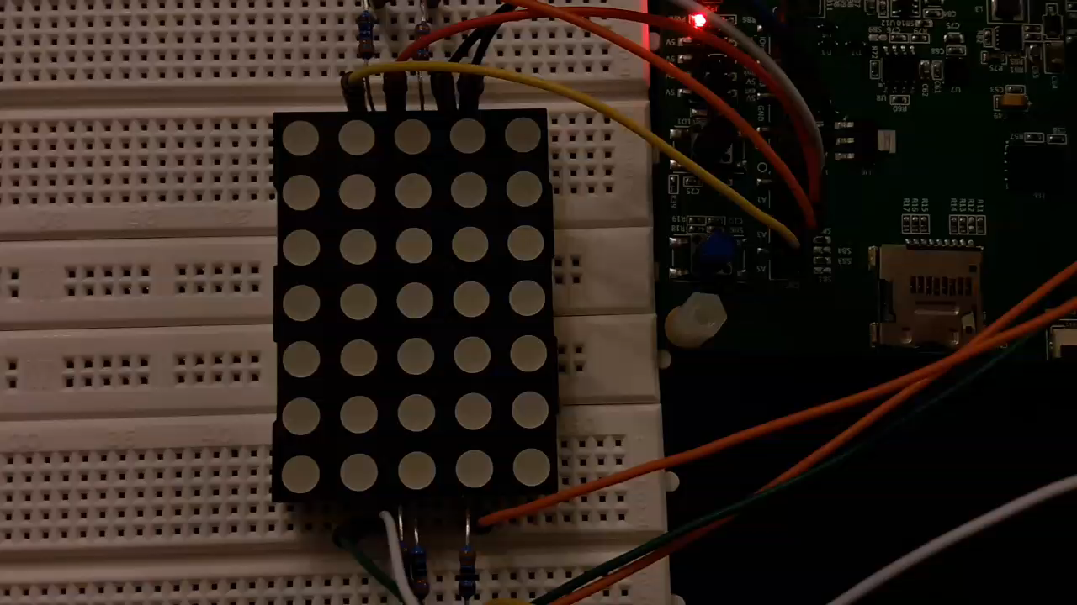
Demo – week 8
András Pásztor
01.12.2017

Slide 2
Floating point number
The problem was…
float multiplier = 1;
On a button push:
multiplier -= 0.1
If multiplier = 0:
multiplier = 1;

Slide 3
Floating point number
The problem was…
float multiplier = 1;
On a button push:
multiplier -= 0.1
If multiplier <= 0:
multiplier = 1;

Slide 4
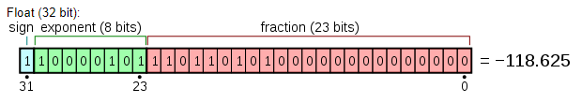
Floating point number
How to store?
IEEE-754 standard

Slide 5
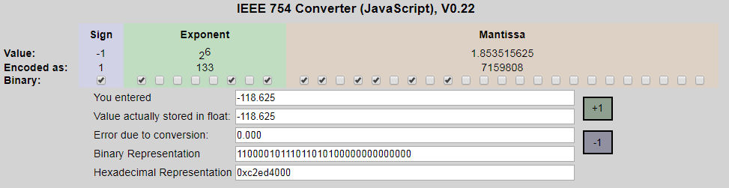
Floating point number
So what is the problem?

Slide 6
Floating point number
So what is the problem?

Slide 7
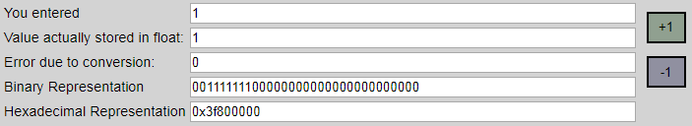
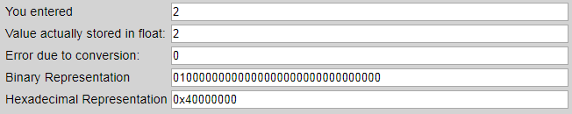
Floating point number
So what is the problem?

Slide 8
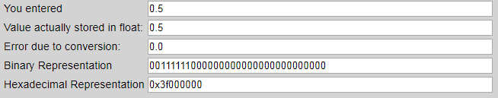
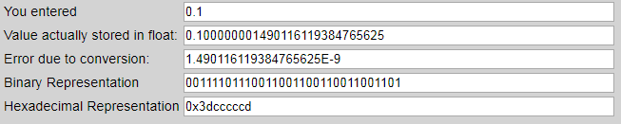
Floating point number
So what is the problem?

Slide 9
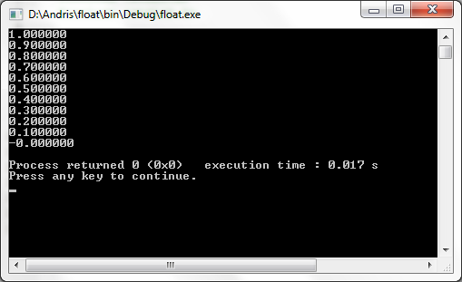
Floating point number
What is the problem?

Slide 10
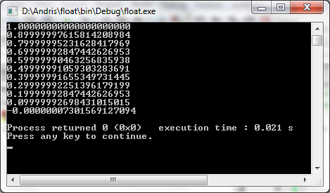
Floating point number
This is the problem!

Slide 11
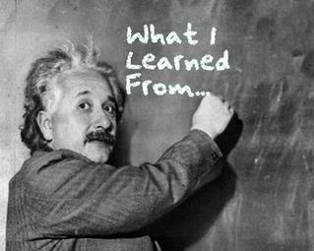
Take Home Message
Be careful with float

Slide 12
Thank you for your attention
András Pásztor

